Slide 1
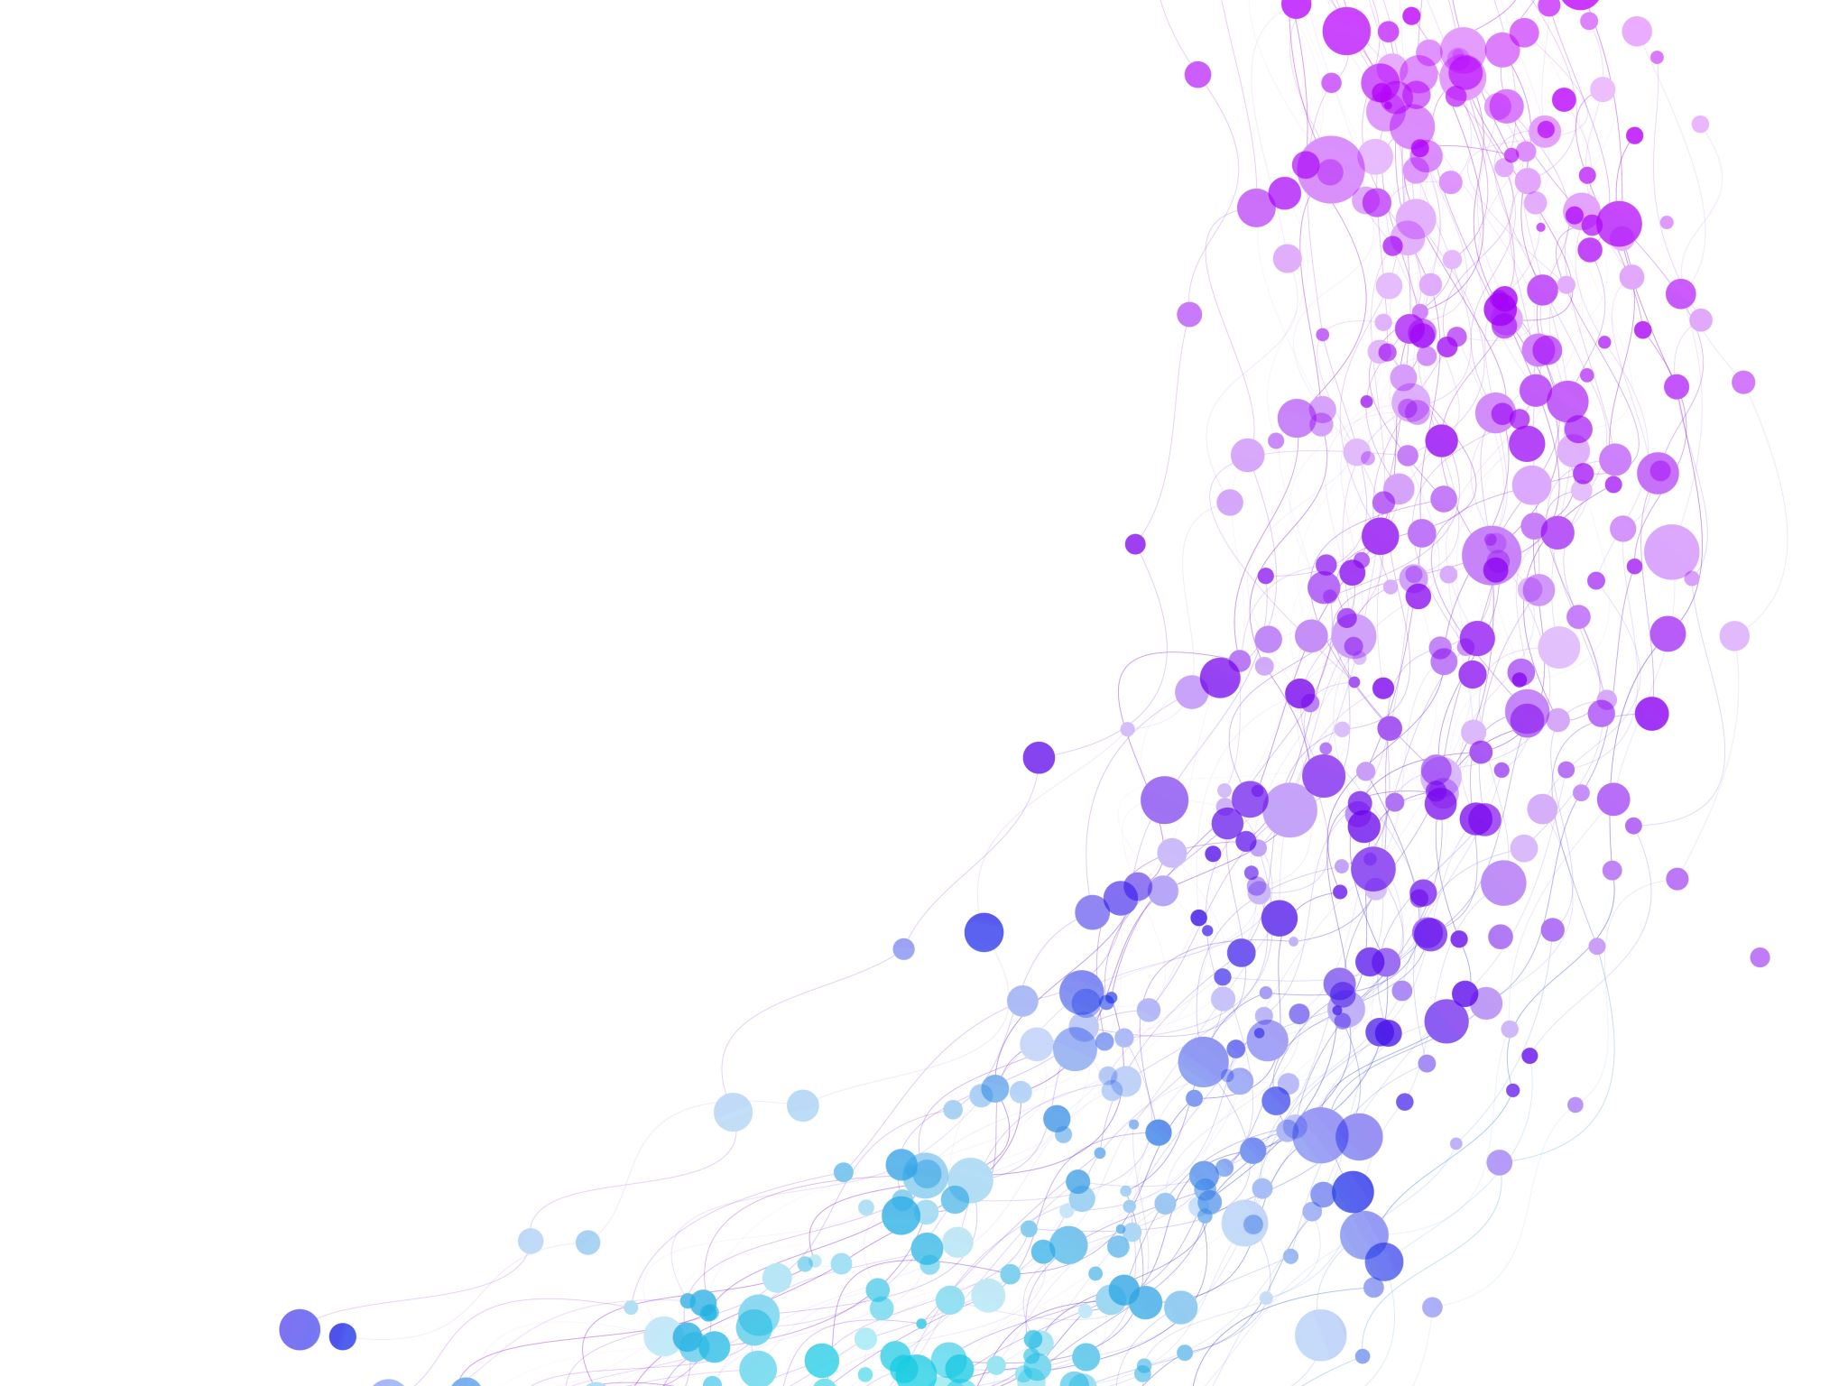


Derivation of Index Formula for 1-D, 2-D, and Multi-D Array Session No.: 5 Course Name: Data Strucutres Course Code: R1UC308B Instructor Name: Dr. Gaura Agarwal Duration: 50 mins Date of Conduction of Class: 28 Aug 2025

Slide 2

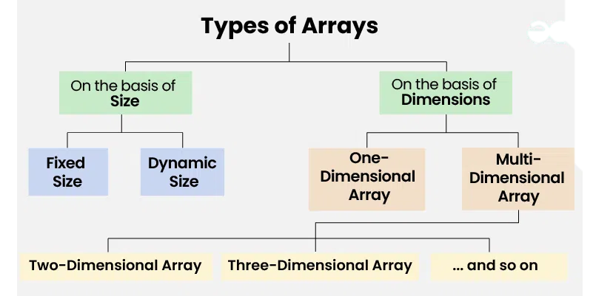
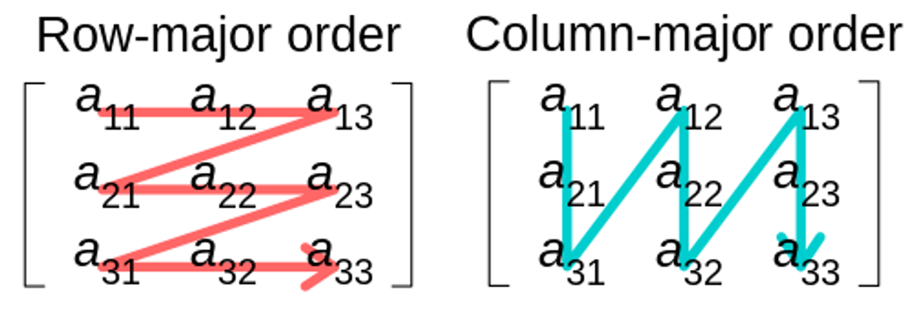
Review

Slide 3
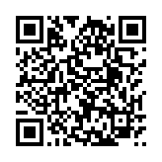
Pre-Class Assessment
[2-mins]
https://app.wooflash.com/moodle/0J24D3IW
Wooflash Code: 0J24D3IW
Join the link and Participate in Pre-class Assessment

Slide 4

[3-mins]
You are the owner of a theater with 20 rows, and 30 seats in each row. Each ticket costs ₹150.
If the last ticket sold was for Row 7, Seat 12,
how much total money have you collected from ticket sales?
(Remember: tickets are sold seat by seat in row-major order — left to right in a row, then next row.)

Slide 5
Learning Outcomes
[2-mins]
By the end of this session, You will be able to:
Explain the process of deriving index formula for 1-D, 2-D, and multi-D arrays in both row-major and column-major order
Apply the formula to calculate the memory address of given elements in 1D, 2D and 3D arrays under different storage orders

Slide 6
Session Outline
Address calculation for 1D array
Address calculation for 2D array following row-major and column-major order
Address calculation for multi-D array following row-major and column-major order
Provide hands-on activities and reinforce learning through an interactive WooClap and WooFlash tools.

Slide 7
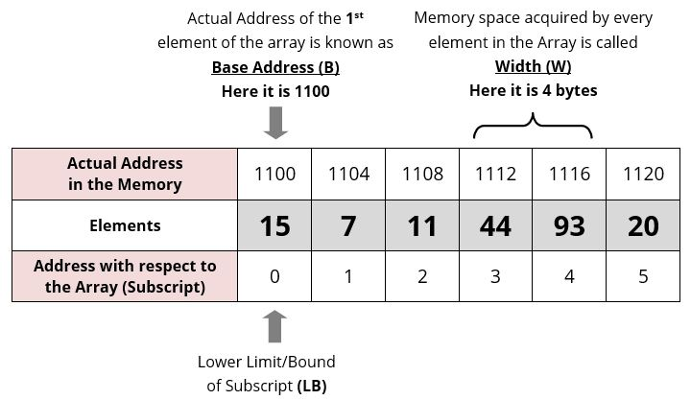
Address of An element in 1D Array

Slide 8
Address of An element in 1D Array
Address of A[Index] = B +W ∗ (Index–LB)
Index = The index of the element whose address is to be found (not the value of the element).
B = Base address of the array.
W = Storage size of one element in bytes.
LB = Lower bound of the index (if not specified, assume
zero).

Slide 9
Address of An element in 2D Array – Row-Major
Address of A[I][J] = B +W ∗ (M ∗ (I–LR) + (J–LC))
I = Row Subset of an element whose address to be found,
J = Column Subset of an element whose address to be found,
B = Base address,
W = Storage size of one element store in an array(in byte),
LR = Lower Limit of row/start row index of the matrix(If not given assume it as zero),
LC = Lower Limit of column/start column index of the matrix(If not given assume it as zero),
M = Number of column given in the matrix.

Slide 10
Address of An element in 2D Array – Column-Major
Address of A[I][J] = B +W ∗ ((I–LR) + N ∗ (J–LC))
I = Row Subset of an element whose address to be found,
J = Column Subset of an element whose address to be found,
B = Base address,
W = Storage size of one element store in an array(in byte),
LR = Lower Limit of row/start row index of the matrix(If not given assume it as zero),
LC = Lower Limit of column/start column index of the matrix(If not given assume it as zero),
N = Number of rows given in the matrix.

Slide 11
Activity: Peer Learning – Array Address Calculation
Instructions for Students
Your group has 6 members. Form 3 pairs (2 students in each pair).
Each pair will receive one type of problem:
Pair 1 → 1D Array
Pair 2 → 2D Array (Row Major Order)
Pair 3 → 2D Array (Column Major Order)
Work with your partner to solve the problem in 5 minutes.
Step 1: Try solving individually for 2 minutes.
Step 2: Discuss and finalize your solution together.
After finishing, be ready to explain your solution to the rest of your group when asked.
Compare answers across pairs inside your group — check similarities and differences in the formulas.

Slide 12
Activity: Peer Learning – Array Address Calculation
Problem 1:
An array A[0…9] is stored in memory with base address 1000. Each element takes 4 bytes.
Find the address of A[6].
Problem 2
A matrix B[0…3][0…4] is stored in row-major order. Base address = 2000, element size = 2 bytes.
Find the address of B[2][3].
Problem 3
A matrix C[1…4][1…5] is stored in column-major order. Base address = 5000, element size = 2 bytes.
Find the address of C[3][4].

Slide 13
Address of An element in Multi-D Array – Row-Major
Address of A[I][J][K] = B +W ∗ (N ∗ L(I − x) + L ∗ (J − y) + (K − z))
B = Base Address (start address)
W = Weight (storage size of one element stored in the array)
N = Hight/Layer (total number of cells depth-wise)
M = Row (total number of rows)
L = Column (total number of columns)
x = Lower Bound of Row
y = Lower Bound of Column
z = Lower Bound of Hight

Slide 14
Address of An element in Multi-D Array – Column-Major
Address of A[I][J][K] = B +W ∗ (N ∗ L ∗ (I −x)+(J −y)+(K −z) ∗N)
B = Base Address (start address)
W = Weight (storage size of one element stored in the array)
N = Hight/Layer (total number of cells depth-wise)
M = Row (total number of rows)
L = Column (total number of columns)
x = Lower Bound of Row
y = Lower Bound of Column
z = Lower Bound of Hight

Slide 15


Slide 16
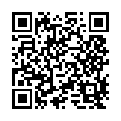
Post-Class Assessment
[2-mins]
https://app.wooflash.com/moodle/WP4VOGWK
Wooflash Code: WP4VOGWK
Join the link and Participate in Post-class Assessment

Slide 17
Summary
[1-mins]
Array Type | Order | Formula | Parameters
1D Array | – | Addr(A[Index]) = B + W × (Index – LB) | B = Base address W = Size of one element (bytes) LB = Lower bound of index
2D Array | Row Major | Addr(A[I][J]) = B + W × ( M × (I – LR) + (J – LC) ) | B = Base address W = Element size LR = Row lower bound LC = Column lower bound M = Number of columns
2D Array | Column Major | Addr(A[I][J]) = B + W × ( (I – LR) + N × (J – LC) ) | N = Number of rows (other symbols as above)
3D Array | Row Major | Addr(A[I][J][K]) = B + W × ( N × L × (I – x) + L × (J – y) + (K – z) ) | B = Base address W = Element size N = Depth/Height M = Rows L = Columns x, y, z = Lower bounds
3D Array | Column Major | Addr(A[I][J][K]) = B + W × ( N × L × (I – x) + (J – y) + (K – z) × N ) | Same as above

Slide 18
[2-mins]
Ensure attainment of LO’s in alignment to the learning activities:
Explain the process of deriving index formula for 1-D, 2-D, and multi-D arrays in both row-major and column-major order
Apply the formula to calculate the memory address of given elements in 1D, 2D and 3D arrays under different storage orders

Slide 19
[1-min]
Next Session:
Application of arrays, Sparse Matrices, and their representations

Slide 20
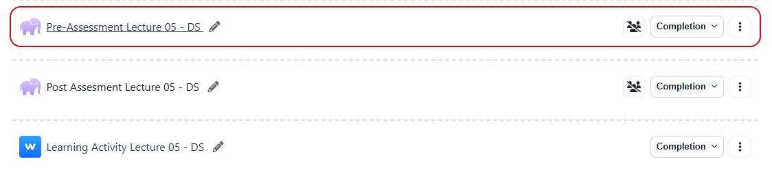
Review and Reflection from students

